Slide 1

Tecnológicas Estratégicas de las Bibliotecas
Funcionalidades Deseables en los sistemas de gestión y descubrimiento
Marshall Breeding
Independent Consultant, Author, and
Founder and Publisher, Library Technology Guides
http://librarytechnology.org/
http://twitter.com/mbreeding
Segundo Workshop National
29 Septiembre 2016

Slide 2
Abstract
Topics covered will include we are very interested in your perceptions about the features that are needed today and that will be in the future for a library management environment. What is the relation of these products to BIBFRAME, the semantic web, the interaction with institutional repositories, challenges in loan of non-traditional items as laptops, ebooks, etc.

Slide 3

Thanks
To OCLC for funding my travel to the workshop

Slide 4
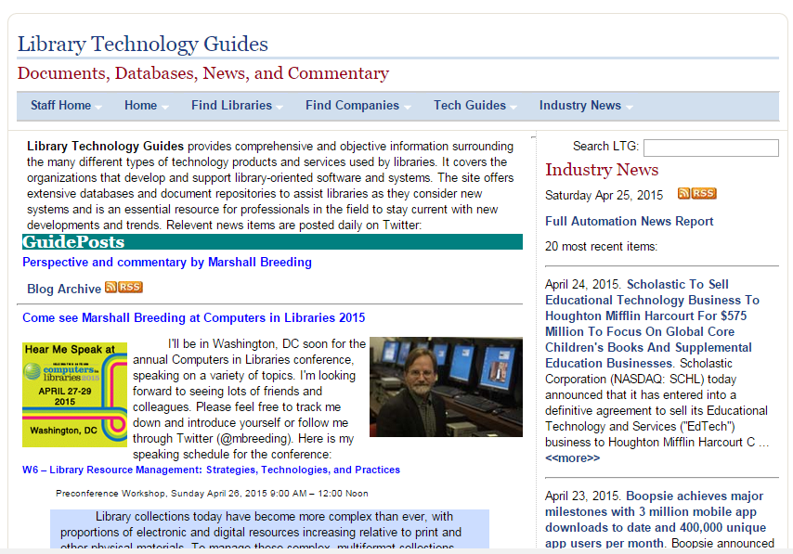
Library Technology Guides
www.librarytechnology.org

Slide 5
Library Technology Industry Reports
American Libraries
Library Journal
2014: Strategic Competition and Cooperation
2015: Operationalizing Innovation
2016: Power Plays
2013: Rush to Innovate
2012: Agents of Change
2011: New Frontier
2010: New Models, Core Systems
2009: Investing in the Future
2008: Opportunity out of turmoil
2007: An industry redefined
2006: Reshuffling the deck
2005: Gradual evolution
2004: Migration down, innovation up
2003: The competition heats up
2002: Capturing the migrating customer

Slide 6

Library Systems Report 2016
“Power Plays”
https://americanlibrariesmagazine.org/2016/05/02/library-systems-report-2016/

Slide 7
Power Plays
The transitions seen in 2015 were not lateral changes of ownership among investors but strategic acquisitions that concentrated power among a smaller number of much larger companies and reassembled product portfolios. Libraries may resist consolidation, but this could enable the development of technology products and services that are less fragmented and better able to support libraries as they provide access to increasingly complex collections.

Slide 8
International Perceptions Report
http://librarytechnology.org/perceptions/2015/
Based on a series of annual surveys addressed to libraries
Probes levels of satisfaction with their automation systems
3,453 responses to 2015 survey
1,050 narrative comments
Conducted since 2007: view trends over time
Data collected Nov-Dec, published early the following year
Linked to entries in libraries.org

Slide 9
Perspective
Increasing divergence among library types regarding requirements for supporting technical infrastructure: Academic, Public, National, School, Special
Approaches to library service vary according to international region
Broad range of economic capacity or support across countries and regions and even within some countries. (especially United States)

Slide 10
Broad Industry Trends
Continued Consolidation
International companies increasingly dominate in a growing set of international regions
Discovery services now routine infrastructure in academic libraries
New Generation systems becoming better established
New and existing systems shifting to hosted or SaaS deployment
Subscription-based technology infrastructure or cloud-housed systems rather than local hardware

Slide 11
Transformation in Bibliographic Management
Traditional bibliographic conventions undergoing transformation
RDA: new set of cataloging rules
Linked Data: increased interest in applying to library collections
BIBFRAME: mapping of MARC21 to Linked Data
Library involvement with institutional research data
Support of Digital Humanities: Text-encoding Initiative and other analytical tools

Slide 12
RDA
Resource Description and Access
  http://www.loc.gov/aba/rda/
Major change relative to resources devoted to transition
Minor impact relative to operational and strategic use of metadata

Slide 13

BIBFRAME
Emerged from the Initiative for Bibliographic Transformation of the Library of Congress
  http://www.loc.gov/bibframe/
  bibframe.org
Replacement for MARC (Machine Readable Cataloging), but broader in scope
Encoded using RDF (Resource Description Framework)
Major departure from MARC
Today more conceptual than operational

Slide 14
Transformación de las tecnologías
Arquitectura orientada a servicios
Énfasis en las Interfaces de programación de aplicaciones
Integración de las aplicaciones sociales en infraestructura básica
Computación local a cambio de plataformas en la nube
Nuevas expectativas para múltiples usuarios de software-as-a-service
Soporte para todos los tipos de dispositivos
  de tamaño completo computadoras / tablet / móvil

Slide 15
Tecnologías de la Computación en Nube
(Cloud Computing)
Las principales tendencias en Tecnología de la Información
Esencialmente la externalización del alojamiento y gestión del servidor
Productos de automatización de la mayoría de las nuevas versiones con un cierto sabor de computación en la nube
Depende del ancho de banda de Internet, que sea rápida y fiable (fast and reliable)

Slide 16
Biblioteca de automatización en la nube
Casi todos los proveedores de automatización de bibliotecas ofrecen algún tipo de servicios basados ​​en la nube
La responsabilidad de la administración de servidores se mueve de la biblioteca a los Proveedores
Basado en suscripción el nuevo modelo de negocio:
  El pago integral de suscripción anual
Reduce la necesidad de apoyar la tecnología local

Slide 17
Cambios en el escenario de automatización de bibliotecas
SIGB (Sistema Integrado de Gestión de Biblioteca) sigue siendo el corazón de la infraestructura
Interés estratégico en tecnologías de descubrimiento
fuerte necesidad de herramientas para gestionar los recursos electrónicos
Tendencia hacia la gestión de recursos unificado

Slide 18
Las tendencias en modelos de implementación de automatización
Mayor interés en proyectos de cooperación para reducir los costos de automatización y para aumentar el impacto de las colecciones
Iniciativas regionales, estatales, nacionales y de infraestructura de automatización
Ejemplos reciente incluyen Dinamarca, Irlanda, Orbis-Cascade Alliance
Los SIGB independientes siguen donde la cooperación a gran escala no es posible

Slide 19
SIGB de código abierto: Escenario Internacional
Fuerte interés en EE.UU., Canadá
  Principalmente a través de servicios de soporte comercial pagados
Muy poco o ningún interés en Asia
El interés sigue creciendo lentamente en Europa
Cada vez mayor interés en el software de código abierto en América Latina

Slide 20
Library software in Developing Nations
Longstanding use of CDS/ISIS based automation tools
  ABCD released as open source
  Other CDS/ISIS tools are freeware, but not open source
Koha seeing widespread adoption
  Increasingly dominant for new automation projects
Commercial products used mostly by larger well-funded institutions

Slide 21
Differences in Latin American Universities
Library systems less likely to be centralized
Many separate libraries in Facultades
Often have separate library management systems
Challenge to provide more systematic resource management and discovery while respecting organizational structure
Proportions of print resources generally higher than US universities

Slide 22
Latin American Industry Trends
International companies target well-funded libraries
As libraries develop, many move to systems from international providers
Many operate through regional distributors
Local systems and open source dominate smaller and less well funded libraries
Cloud technologies often less well suited
  Bandwidth, annual subscription costs

Slide 23
Academic Library Trends

Slide 24
Operational trends in large Academic Libraries
Spending on Electronic Resources dominates budgets
Generally flat budgets + 4% annual inflation = budget stress
Decreasing spending on print monographs
Transition from print to electronic journals complete, shift to e-books underway.
Shift physical spaces from collections to user-oriented facilities: computer labs, creative commons, collaborative work areas

Slide 25
Academic library print collections
Smaller, but unique collections
Many libraries shift print collections to off-site storage
Monographs increasingly electronic:
  E-book collections built via demand driven acquisitions

Slide 26
Resource management technology
Integrated Library Systems
  (mostly oriented to print)
Library services platforms
  Electronic+print+digital

Slide 27
Trends in Resource Sharing
Ongoing reliance on traditional ILL
Direct consortial borrowing
Shared technical infrastructure
  Multiple independent libraries
  Collaborative collection development
  Collective Discovery
  Expedited request delivery

Slide 28
Shared Technology Infrastructure
Increasing interest in shared technology infrastructure among members of library systems and consortia
Shift from stand-alone implementations to shared infrastructure
Remove obstacles to strategic collaboration
  Collaborative Collection Development
  Shared access to collections
  Re-distribution of technical services
  Ability to share language experts and subject specialists

Slide 29
Shared infrastructure Projects
Orbis Cascade Alliance
WHELF (Academic libraries in Wales)
South Australia
Ireland Public Libraries
JULAC (Public Universities in Hong Kong)
California State University
University System of Georgia
Complete Florida Plus Program
University of Wisconsin system

Slide 30
Library Services Platforms
New genre of resource management
Workflows unified across electronic, print, and digital formats
Flexible metadata management: MARC, Dublin Core, BIBFRAME, etc
Deployed via web-native multi-tenant platform
Built-in analytics and decision support
Examples:
  OCLC WorldShare Management Services
  Ex Libris Alma

Slide 31
Shift from: Integrated library systems
More oriented to print resources
Server-based technology (hosted or local)
Workstation clients for staff functions
Traditional organization of functional modules: Cataloging, Acquisitions, Serials management, Circulation.

Slide 32
Adoption trends
Still relatively early in transition cycle
Association of Research Libraries : 33 out of 120 Academic members have purchased a library services platform
Very early adoption stage in developing nations

Slide 33
Interoperability and Extensibility
Strong reliance on APIs to dynamically interact with data and functionality of the technology platform
Create new services not in the core product
Interact with other relevant systems:
  Student records
  Financial management systems
  Suppliers
  Libraries and other collaborative partners

Slide 34
Express data and functionality externally
Learning Management Systems
  Reading lists
External scholarly or professional portals

Slide 35
The Evolution of Library Resource Discovery

Slide 36
Index-based Discovery
One tier of a multi-level approach to providing access to collection resources
Based on central index populated with article-level metadata and full-text spanning most of the universe of scholarly and professional literature
Billions of items indexed
Instant relevancy-based search results
Interface components with increasing sophistication for exploring library collections

Slide 37
Major Discovery Products
ProQuest: Primo + Primo Central; Summon
EBSCO Discovery Service
WorldCat Discovery Service

Slide 38
Challenge: More integrated approach to information and service delivery
Library Web sites offer a menu of unconnected silos:
  Books: Library OPAC (ILS online catalog module)
  Search the Web site
  Articles: Aggregated content products, e-journal collections
  OpenURL linking services
  E-journal finding aids (Often managed by link resolver)
  Subject guides (e.g. Springshare LibGuides)
  Local digital collections
    ETDs, photos, rich media collections
  Metasearch engines
  Discovery Services – often just another choice among many
All searched separately
Notes:
Compare to Amazon.com where a very complex business environment is presented seamlessly.

Slide 39
Online Catalog
ILS Data
Search:
Scope of Search
Search Results
Books, Journals, and Media at the Title Level
Not in scope:
  Articles
  Book Chapters
  Digital objects
  Web site content
  Etc.

Slide 40




Web-scale Index-based Discovery
ILS Data
(2009- present)
Digital Collections
Search:
Web Site Content
Institutional Repositories
Search Results
Aggregated Content packages
Consolidated Index
Profile of Library Subscriptions
Open Access
…
E-Journals
Usage-generated
Data
Customer
Profile
Reference Sources
Pre-built harvesting and indexing

Slide 41
Open source in Discovery
Flexible and powerful open source interfaces:
  VuFind (php-based)
  Blacklight (Ruby on Rails)
No open access discovery index
Hybrid model:
  Open source interface +
  Commercial Index

Slide 42
Bento Box Discovery Model
Aggregated Content packages
Search:
Open Access
ILS Data
VuFind / Blacklight
E-Journals
Search Results
Consolidated Index
Web Site Content
Digital Collections
Institutional Repositories
Pre-built harvesting and indexing

Slide 43
Open Source Library Technology

Slide 44
Trends in Open Source
Open source now a routine segment of strategic library automation
Implementation models:
  Commercial support
  Independent with community support
  Support through governmental organizations
Development models
  Mostly centralized within a commercial community
  Distributed community

Slide 45
Open source in Latin America
Commercial software often not affordable
More reliance on Open source software
Support by Governmental or Educational organizations
Local or regional support communities

Slide 46
ABCD
Automatización de Bibliotecas y Centros de Documentación
CDS/ISIS used extensively in developing nations
CDS/ISIS: freeware initially developed by UNESCO
Development led by BIRME in Brazil
ABCD: New application based on CDS/ISIS tools
ABCD developed as an open source integrated library system.

Slide 47
Koha
Open source ILS available since 1999
Continuous development
Widespread deployment in all regions and library types
Small to mid-sized libraries; some large implementations

Slide 48
Koha
Originally developed in 1999 for small group of libraries in New Zealand, Horowhenua Library Trust by Katipo Communications, production use by January 2000
Gained widespread use in the United States around 2004-05 and has seen steady growth in use
Wide international adoption
Used in many thousands of libraries. 2,682 represented in libraries.org, with many large groups not yet registered.
Dominant open source SIGB in Latin America

Slide 49
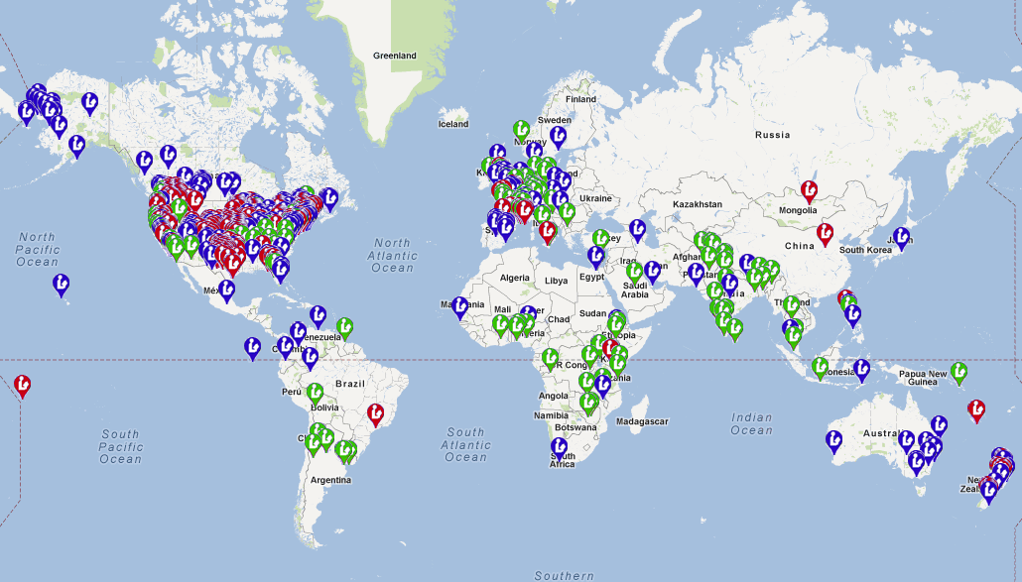
Koha Worldwide

Slide 50
National Projects to deploy Koha
Philippines: A systematic effort to install Koha in the public libraries sponsored by the state libraries
Turkey: 1,200+ public libraries
Spain: Koha-Kobli http://kobli.bage.es/
Argentina. CONABIP (Comisión Nacional de Bibliotecas Populares)
  Customized version of Koha: DigiBepe
  http://www.conabip.gob.ar/faq/digibepe

Slide 51
Evergreen
Open source ILS originally developed for PINES consortium in Georgia
Optimized for large consortia comprised of small to mid-sized public libraries
Mostly implemented within United States and Canada

Slide 52

Evergreen
SIGB de código abierto desarrollado por el Sistema de Bibliotecas Públicas de Georgia en los Estados Unidos
Apoyado y desarrollado por una empresa llamada Equinox
Software originalmente diseñado para grandes consorcios compose de pequeñas bibliotecas
Se utiliza principalmente en los Estados Unidos y Canadá.
No implementaciones en de América Latina
Ver: http://www.open-ils.org/

Slide 53
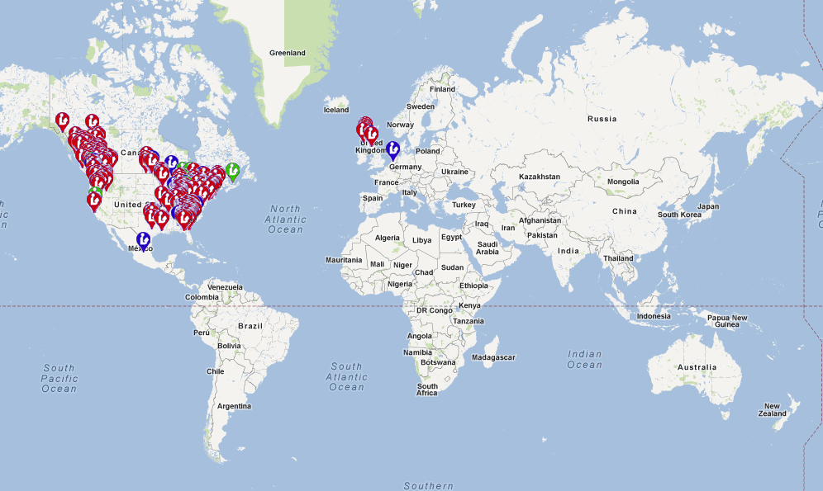
Evergreen Worldwide

Slide 54
ABCD
Automatización de Bibliotecas y Centros de Documentación
CDS/ISIS used extensively in developing nations
CDS/ISIS: freeware initially developed by UNESCO
Development led by BIRME in Brazil
ABCD: New application based on CDS/ISIS tools
ABCD developed as an open source integrated library system.

Slide 55
Open Source Discovery
VuFind
  Originally developed at Villanova University
  Widely used by public and academic libraries
  Pika variant with e-book lending integration
  SOLR indexing; PHP programming framework
Blacklight
  Aligned with Project Hydra
  Used by large Academic libraries
  SOLR indexing; Ruby on Rails framework

Slide 56
PMB (PhpMyBibli)
Originally developed in 2002 in France
Used by many small to mid-sized libraries
Some use in Latin Amarica

Slide 57
FOLIO open source Project
Future of the Library is Open
Sponsored by EBSCO
  Major source of funding
  Technology leadership
  Initial development by Index Data
  Anticipation of community-based development
  Lightweight microservices oriented platform
  Modular functional design with pluggable apps

Slide 58
FOLIO (Future of the library is Open)
New open source library services platform sponsored by EBSCO
Early in development phase; developer’s framework expected to be available in October 2016
Taps into community created via Kuali OLE

Slide 59
Kuali OLE
No longer an active project
Maintenance development of current releases (mostly print)
3 implementations: University of Chicago, Lehigh University, SOAS
Multiple rounds of funding from Andrew W. Mellon Foundation
Open Library Environment community now involved with FOLIO

Slide 60
VuFind
Open source discovery interface
Based on Apache SOLR with PHP programming framework
Relevancy-based retrieval, faceted navigation
Widespread implementations globally
Several variants and customizations

Slide 61
Blacklight
Open source discovery interface
Based on Apache SOLR and Ruby on Rails programming framework
Relevancy based retrieval, faceted navigation
Allied with Project Hydra
More tightly-knit development community

Slide 62
Observations and Conclusions
Narrowing Budgets drive need for Strategic Tech
Industry consolidation has narrowed Product Options
Remaining options increasingly powerful
Targeted Innovation: Libraries must focus on technology services with the most customer impact

Slide 63
Challenges and opportunities for Latin America
Selective adoption of global trends
Some opportunities to acquire services from global providers
Spirit of technical proficiency and innovation
Exercise APIs of commercial systems
Adopt open source solutions and participate in their development communities
Create technical infrastructure to support unique character of libraries in Chile and Latin America

Slide 64
Questions and discussion

